Slide 1
Operations Management
Mohammad Faraz Naim
Assistant Professor, Department of Management, BITS Pilani, Pilani campus

Slide 2
Learning objectives
Operation Management Overview
Operations Management using Value Chain Management
Techniques for Allocating Resources in Operations Management
Scenario Planning in Operations Management
Integrated Understanding of Operations Management

Slide 3
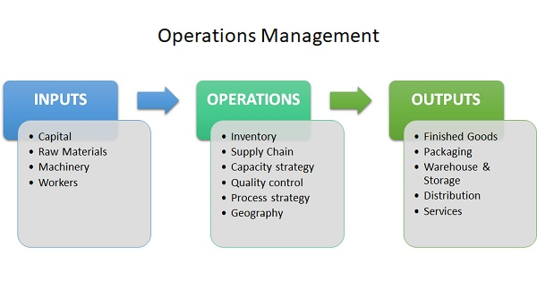
Overview
Operations Management deals with designing, controlling, and improving the processes. It ensures efficient transformation of inputs into outputs.
Example: Managing production in a factory or service delivery in hospitals.
Objectives of Operations Management:
Productivity: Maximize output with minimum input.
Quality: Maintain consistent standards.
Cost Efficiency: Reduce wastage and optimize expenses.
Customer Satisfaction: Deliver value and meet expectations.

Slide 4
Cont’d..
Key aspects of operations management include:
Production & Service Planning: Planning and organising the day-to-day activities to create goods or services.
Quality Control: Ensuring products meet standards and client expectations.
Supply Chain Management: Overseeing logistics and purchasing to ensure smooth operations
Process Optimisation: Improving manufacturing or service procedures for higher productivity.
Inventory Management: Balancing inventory levels to minimise costs.

Slide 5
Cont’d..
Importance & Benefits:
Efficiency: Streamlines production to enhance speed and reduce costs.
Profitability: Ensures effective resource use to maximize operating profits.
Customer Satisfaction: Ensures timely delivery of high-quality goods.
Competitive Advantage: Improves business functioning in fast-paced markets.
Core Components of Operations Management
Operation strategy & Planning: Aligning long-term goals with day-to-day operations, including facility location, capacity planning, and resource allocation.
Product & Service design: Developing products and services that meet customer needs, balancing cost-effectiveness with quality.

Slide 6
Cont’d..
Supply Chain Management: Managing procurement, logistics, and supplier relationships to ensure a smooth flow of materials and goods.
Inventory Management: Controlling inventory levels to ensure sufficient raw materials and finished goods are available to avoid shortages while minimizing holding costs.
Quality control and management: Setting performance standards, conducting inspections, and implementing improvements (like Lean or Six Sigma) to ensure consistent quality and minimize defects.
Forecasting and scheduling: Predicting future demand and planning production schedules to optimize efficiency and resource use.
https://www.youtube.com/watch?v=l-MnHBREzG8

Slide 7
Value Chain Management
Operations management involves managing processes that convert inputs into outputs efficiently. Using Value Chain Management (by Michael Porter), organizations break down their activities into primary and support functions to understand how value is created at each stage. This helps in identifying inefficiencies, reducing costs, and improving coordination across departments.
Value Chain Diagram :
Video : https://www.youtube.com/watch?v=g8p2H7EvoGM
Inbound
Operations
Outbound
Marketing
Service

Slide 8
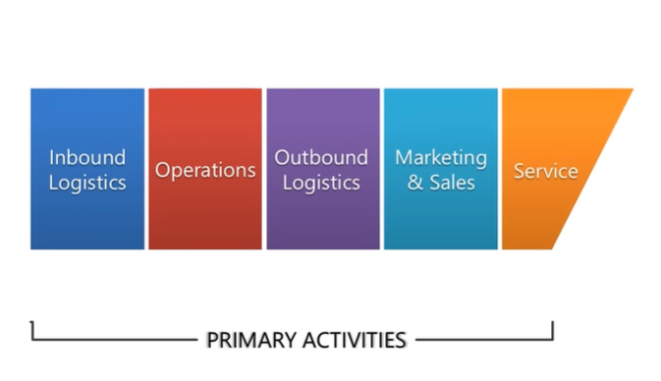
Cont’d..
Key Activities in Value Chain
The value chain consists of:
1. PRIMARY ACTIVITIES
Inbound Logistics: Receiving and storing raw materials.
Operations: Converting inputs into final product.
Outbound Logistics: Delivering products to customers.
Marketing & Sales: Promoting and selling products.
Service: After-sales support.

Slide 9
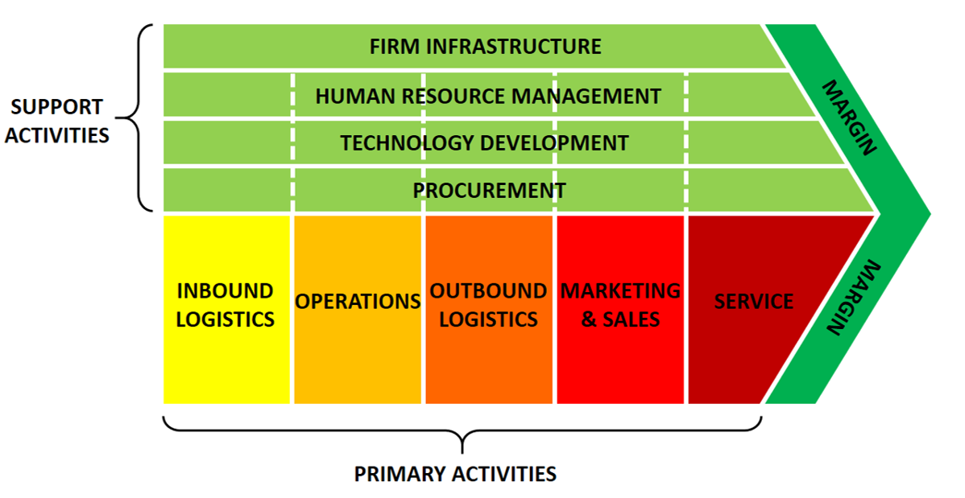
Cont’d..
2. SUPPORT ACTIVITIES:
Firm Infrastructure: Management and finance systems.
HR Management: Hiring and training employees.
Technology Development: Innovation and improvement.
Procurement: Purchasing inputs.

Slide 10
Cont’d..
Example – Zara
Zara is a classic example of strong value chain management. It has a highly responsive supply chain where design, production, and distribution are closely integrated. Unlike traditional brands, Zara produces in small batches and quickly responds to changing fashion trends. Its efficient inbound logistics (fast sourcing), operations (in-house production), and outbound logistics (rapid distribution to stores) allow it to deliver new designs within weeks. This tight control over the value chain gives Zara a strong competitive advantage.
Example – Zomato
In the case of Zomato, the value chain is service-oriented. Inbound logistics involves onboarding restaurants, operations include managing the app and order processing, outbound logistics is food delivery, and service includes customer support and refunds. By optimizing each stage (like real-time tracking and delivery efficiency), Zomato enhances customer experience and operational efficiency.

Slide 11
Techniques for Allocating Resources in Operations Management
Resource allocation refers to the effective distribution of limited resources such as labor, capital, time, and materials. The goal is to maximize output while minimizing waste and cost. Efficient allocation ensures smooth operations and better decision-making.
1. Linear Programming
Linear programming is a mathematical technique used to determine the best allocation of resources under given constraints. It helps organizations maximize profit or minimize costs.
Example – Zara Zara uses optimization techniques to decide how much of each clothing design to produce, considering constraints like fabric availability, labor, and time. This prevents overproduction and reduces inventory costs.

Slide 12
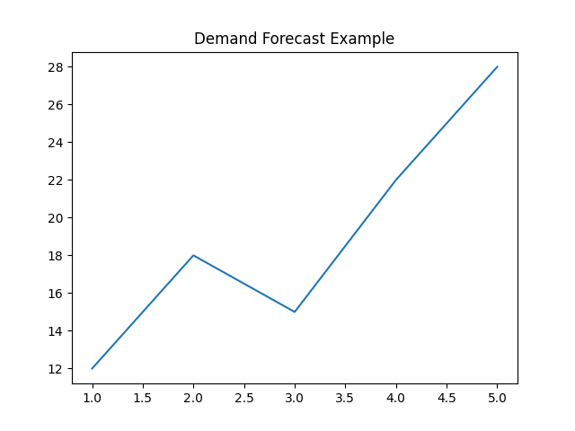
Cont’d..
2.Forecasting
Forecasting uses historical data and trends to predict future demand, helping in planning production and resource allocation.
Example – Zara Zara forecasts fashion trends and customer preferences using sales data, allowing it to produce designs that are more likely to sell, reducing unsold inventory.

Slide 13
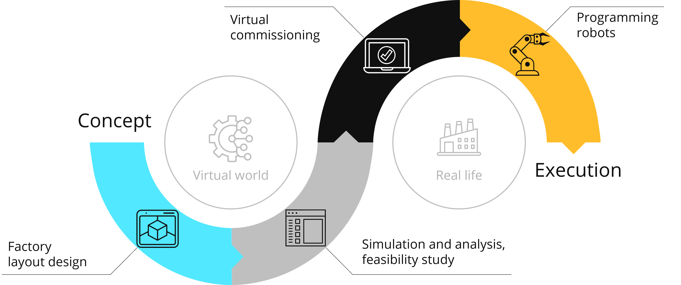
Cont’d..
3. Simulation
Simulation involves creating virtual models of real-world systems to test different scenarios without actual risk.
Example – Zomato Zomato can simulate delivery routes and rider allocation to determine the fastest and most efficient delivery patterns during peak hours, improving service speed.

Slide 14
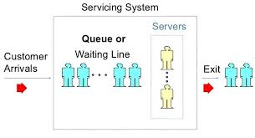
Cont’d..
4. Queuing Models
Queuing models help manage waiting lines and service efficiency.
Example – Zomato Zomato uses algorithms similar to queuing models to assign delivery partners efficiently, reducing customer waiting time and improving satisfaction.

Slide 15
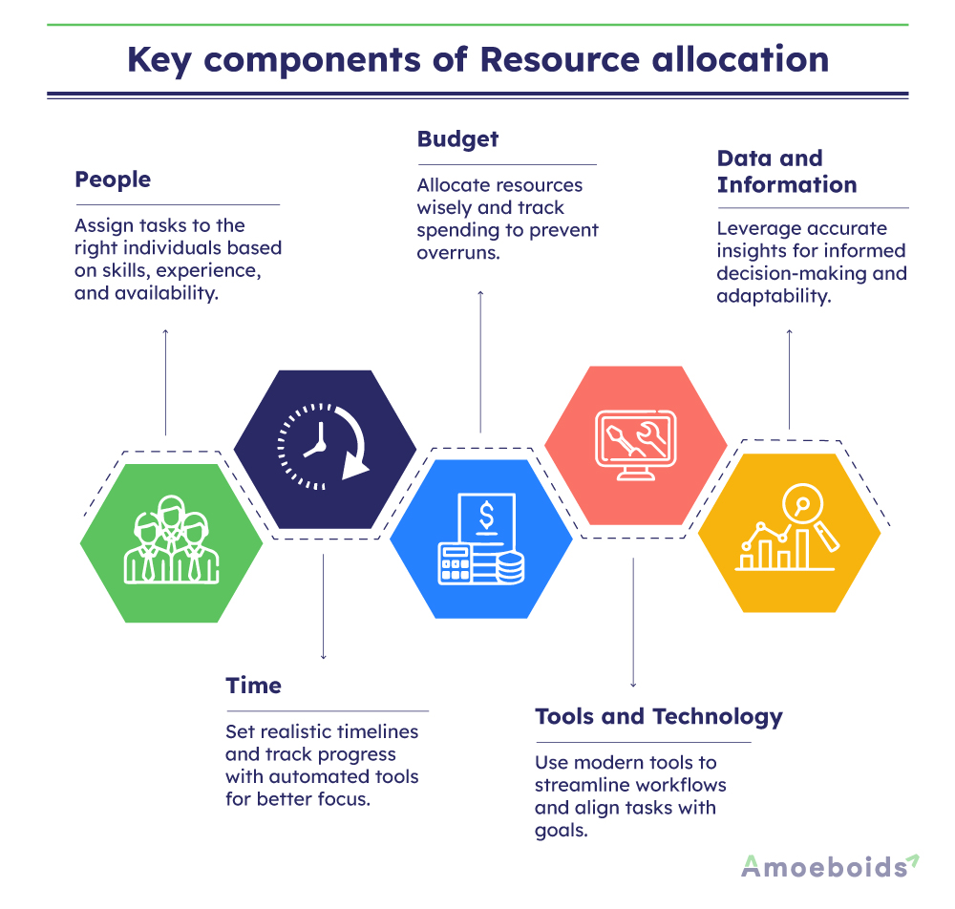
Cont’d..
5. Resource allocation
It refers to assigning available resources effectively. Includes manpower, machinery, money, and materials.
Goal: Maximize efficiency and minimize waste.

Slide 16
Scenario Planning
Scenario planning is a strategic tool used in operations management to prepare for uncertainty and future risks. Instead of relying on a single forecast, scenario planning involves developing multiple plausible future scenarios based on different assumptions about key factors such as market demand, economic conditions, or supply chain disruptions. This approach allows organizations to remain flexible and resilient in the face of change.
The process of scenario planning typically involves identifying critical drivers of change, constructing different scenarios (such as best-case, worst-case, and most likely situations), analyzing their potential impact on operations, and developing appropriate strategies for each scenario.
For example, during situations like a pandemic or economic crisis, businesses may prepare separate plans for high demand, low demand, or supply shortages.

Slide 17
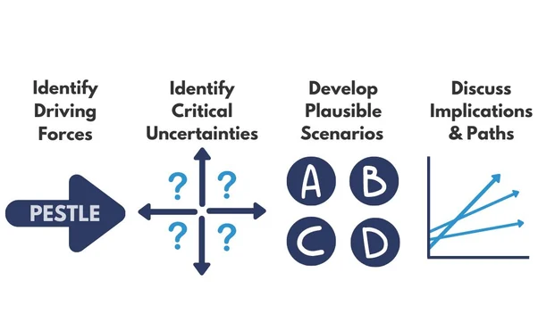
Process of Scenario Planning
Identifying key drivers (market demand, supply chain, economy)
Developing different scenarios (best case, worst case, most likely)
Analyzing impacts on operations
Preparing strategies for each scenario

Slide 18
Cont’d..
Example – Zara
Zara uses scenario planning to handle demand uncertainty. For example, if a particular fashion trend suddenly declines, Zara quickly reduces production and shifts to new designs. This flexibility minimizes losses.
Example – Zomato
During events like lockdowns, Zomato adapted by focusing more on food delivery and safety measures. It prepared for different demand scenarios (low dine-in, high delivery), ensuring business continuity.
Applications of Scenario Planning:
Supply chain management
Risk mitigation
Demand fluctuation handling

Slide 19
Cont’d..
Challenges:
Data accuracy issues
Complex implementation
Resistance to change
Scenario Examples:
Pandemic situation
High vs low demand
Prepared strategies reduce risk
By incorporating scenario planning into operations management, organizations can improve decision-making, reduce uncertainty, and respond more effectively to unexpected events. It enhances organizational agility and ensures continuity of operations even under adverse conditions.

Slide 20
Integrated Understanding of Operations Management
Operations management becomes highly effective when value chain management, resource allocation, and scenario planning are used together. Value chain analysis identifies where value is created, resource allocation ensures optimal use of inputs, and scenario planning prepares the organization for uncertainties.
For example, Zara integrates all three by managing its supply chain efficiently, allocating resources based on demand forecasts, and staying flexible to changing fashion trends. Similarly, Zomato combines efficient service operations, smart resource allocation, and adaptive strategies to handle dynamic market conditions.

Slide 21
Cont’d..
Effective operations management requires a holistic view of the business, including resource allocation, documentation review, quality control, coordination of efforts, sharing information across departments, and initiating appropriate actions when needed. Typically, operations managers have a cross-departmental view, carry out duties assigned by leaders, ensure the efficient use of resources, and help plan and prepare to achieve future goals. Day-to-day operational management tasks include record-keeping and operational reporting.

Slide 22
Case study
NovaTech Appliances Pvt. Ltd. is a mid-sized company that manufactures smart home devices such as air purifiers, smart fans, and energy-efficient heaters. Over the past three years, the company has experienced steady growth due to increasing demand for smart and sustainable products.
However, in the current year, NovaTech is facing multiple challenges. Rising raw material costs, supply chain disruptions, and fluctuating customer demand have created uncertainty in its operations. The operations manager has observed frequent delays in production schedules and increasing inventory holding costs.
To address these issues, the management team decided to adopt a structured approach. First, they reviewed their operations management practices and found inefficiencies in production planning and inventory control. Machines were underutilized during some periods, while at other times, there was excessive workload leading to overtime costs.
To deal with uncertainty, the company introduced scenario planning. Three scenarios were developed:
Optimistic scenario: Demand increases due to festive season and new product launch.
Moderate scenario: Demand remains stable with minor fluctuations.
Pessimistic scenario: Demand declines due to economic slowdown and increased competition.

Slide 23
Cont’d..
Each scenario required different operational strategies. For example, in the optimistic case, the company would need higher production capacity and workforce allocation, while in the pessimistic case, cost control and inventory reduction would be critical.
The biggest challenge for NovaTech was resource allocation. The company had limited financial resources and had to decide how to allocate them among production, marketing, and technology upgrades. The management had to balance between investing in automation to improve efficiency and maintaining sufficient working capital to manage day-to-day operations.
After careful analysis, NovaTech decided to adopt flexible production scheduling, improve demand forecasting, and allocate resources dynamically based on scenario outcomes. This helped the company reduce costs, improve responsiveness, and better prepare for future uncertainties.

Slide 24
Cont’d..
Identify the key operations management issues faced by NovaTech.
Suggest strategies to improve operational efficiency.
ow can NovaTech balance cost, quality, and flexibility

Slide 25

Thank you
Contact: mfaraznaim@pilani.bits-pilani.ac.in

